Slide 1




TACTICAL COMBAT CASUALTY CARE COURSE
Module 16: Antibiotic Administration
#TCCC-CPP-PPT-16 08 AUG 23
COMBAT PARAMEDIC/ PROVIDER
MODULE 16:
ANTIBIOTIC ADMINISTRATION
TCCC TIER 1
All Service Members
TCCC TIER 2
Combat Lifesaver
TCCC TIER 3
Combat Medic/Corpsman
TCCC TIER 4
Combat Paramedic/Provider

Slide 2




Module 16: Antibiotic Administration
TACTICAL COMBAT CASUALTY CARE (TCCC) ROLE-BASED TRAINING SPECTRUM
ROLE 1 CARE
NONMEDICAL PERSONNEL
MEDICAL PERSONNEL
YOU ARE HERE
STANDARDIZED JOINT CURRICULUM
#TCCC-CPP-PPT-16 08 AUG 23
2
Notes:
This module discusses antibiotic indications and administration in the Tactical Field Care (TFC) setting, highlighting the medications you will potentially use as a Combat Paramedic or Provider (CPP).
All Service Member and Combat Lifesaver training trains non-medical personnel about the Combat Wound Medication Pack (CWMP), and Combat Medics are trained on additional antibiotic options to consider. As a CCP, you not only need to know all of that information, you should also understand how the guidelines were developed and be able to answer questions about antibiotic administration in a TFC environment.

Slide 3
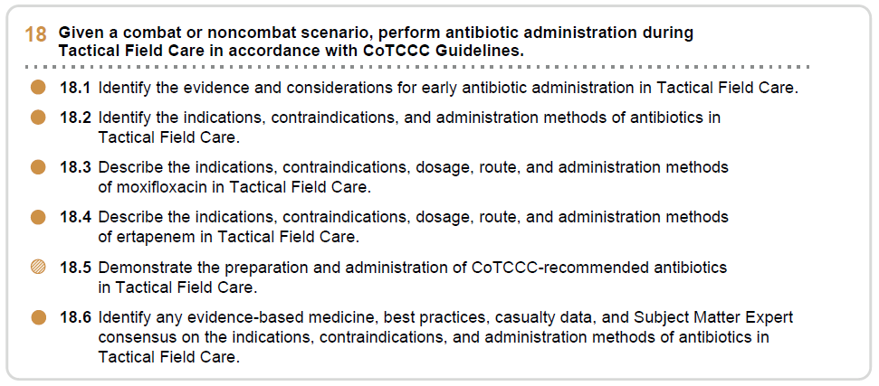








Module 16: Antibiotic Administration
1 x TERMINAL LEARNING OBJECTIVES
18
Given a combat or noncombat scenario, perform antibiotic administration during Tactical Field Care in accordance with CoTCCC Guidelines.
  Identify the evidence and considerations for early antibiotic administration in Tactical Field Care.
  Identify the indications, contraindications, and administration methods of antibiotics in Tactical Field Care.
  Describe the indications, contraindications, dosage, route, and administration methods of moxifloxacin in Tactical Field Care.
  Describe the indications, contraindications, dosage, route, and administration methods of ertapenem in Tactical Field Care.
  Demonstrate the preparation and administration of CoTCCC-recommended antibiotics in Tactical Field Care.
  Identify any evidence-based medicine, best practices, casualty data, and Subject Matter Expert consensus on the indications, contraindications, and administration methods of antibiotics in Tactical Field Care.
06 x ENABLING LEARNING OBJECTIVES
= Terminal Learning Objectives = Cognitive ELOs = Performance ELOs
#
#TCCC-CPP-PPT-16 08 AUG 23
3
Notes:
There are five cognitive and one performance-enabling learning objectives covered in this module.
The identification and significance of early antibiotics and the methods of antibiotic administration will be reviewed. Specific consideration of the indications and contraindications for oral moxifloxacin and parenteral ertapenem will also be discussed. Additionally, the evidence for the strategies behind the use of antibiotics in the TFC setting will be covered.
The performance learning objective will target the preparation and administration of antibiotics in a Tactical Field Care setting.

Slide 4
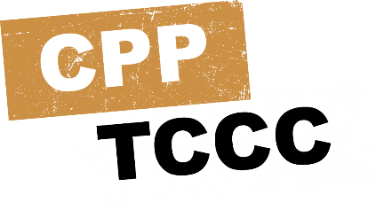
MARCH PAWS
Module 16: Antibiotic Administration
LIFE-THREATENING
AFTER LIFE-THREATENING
M MASSIVE BLEEDING
#1 Priority
A AIRWAY
R RESPIRATION (Breathing)
C CIRCULATION
_{H} HYPOTHERMIA / HEAD INJURIES
P
PAIN
A
ANTIBIOTICS
W S
WOUNDS
SPLINTING
#TCCC-CPP-PPT-16 08 AUG 23
Notes:
Antibiotics are the second “A” in the MARCH PAWS sequence.

Slide 5
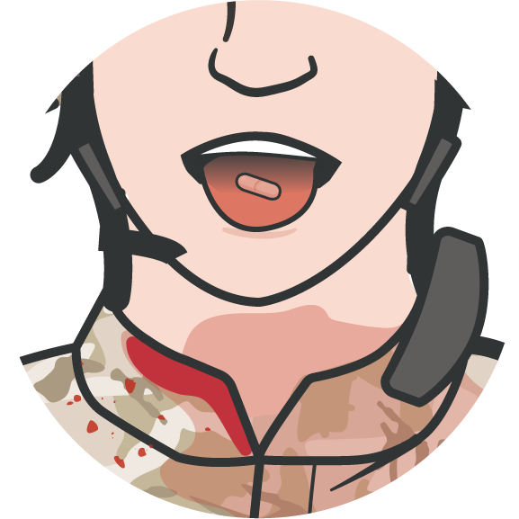
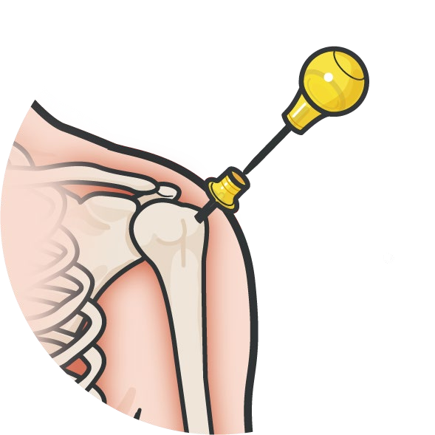


THE IMPORTANCE OF EARLY ANTIBIOTIC ADMINISTRATION
Module 16: Antibiotic Administration
1944
WWII Penicillin administered at front line surgical units saved lives
1950/
60s
Korea & Vietnam Recommended battlefield antibiotics for any delays in evacuation to hospitals
1993
Battle of Mogadishu (1993) 16/58 casualties’ wounds infected with 15-hour delay to treatment
1996
Initial TCCC Guidelines recommend battlefield antibiotics
Antibiotics must be given as soon as possible after injury to maximize their ability to prevent wound infections
2003
Battle of Iraq – Road to Baghdad (2003) 32 casualties treated in battlefield had negligible infections despite 11-hour evac delay
2007
TCCC review noted no reports of adverse effects from the use of battlefield antibiotics during GWOT operations
Level of Evidence: C-LD
P A W S
#TCCC-CPP-PPT-16 08 AUG 23
Notes:
Although penicillin was discovered in 1928, it took over a decade before it was being looked at as a potential solution for a wide variety of infections. At the beginning of World War II, drug companies, supported by the War Production Board, developed processes to scale up production; and by 1943-1944 penicillin was reaching forward military locations. Soon afterward, later in 1944, the first publication demonstrating the improved outcomes of soldiers treated at the surgical units closest to the front was published.¹ Anecdotal and retrospective reviews throughout subsequent conflicts continued to confirm that delaying treatment until casualties arrived at rear hospitals led to worse outcomes, and recommendations for field administration were made, if evacuation times would be delayed by several hours.²
During the 1993 battle of Mogadishu, a 15-hour delay without antibiotics before treatment at a forward surgical facility resulted in wound infections in 16 of the 58 casualties, for an infection rate of 28%.³ Subsequently, battlefield antibiotics were recommended in the first TCCC Guidelines.⁴ Later, at the beginning of the war in Iraq, 32 casualties from the drive to Baghdad at the start of the war received early antibiotics on the battlefield and a negligible rate of infections was achieved, despite casualty evacuation often being delayed.⁵ And in a separate review of 19 Specials Forces medics and 30 Iraqi military forces treated with antibiotics on the battlefield, no infections were noted despite an 11-hour delay in evacuation.⁶
Animal models have also validated that antibiotics must be given as soon as possible after injury to maximize their ability to prevent wound infections. For example, in one study, a delay of 6 hours had a profound detrimental effect on the infection rate compared to early administration, regardless of the timing of surgery.⁷
A 2007 review of TCCC as used on the battlefields of the Global War on Terrorism noted there were no reports of adverse effects from the use of battlefield antibiotics, speaking to the safety profile of early administration of antibiotics.⁸
Although antibiotics are not used in most civilian prehospital emergency medical systems with short transport times, definitive care for casualties may be significantly delayed in combat settings due to the longer distances to be covered and tactical constraints on evacuation assets. Antibiotics must be given as soon as possible after injury to maximize their ability to prevent wound infections(9). The evidence supporting the importance of early antibiotic administration is mostly retrospective registry review, lab evaluation observational study with limitations.

Slide 6
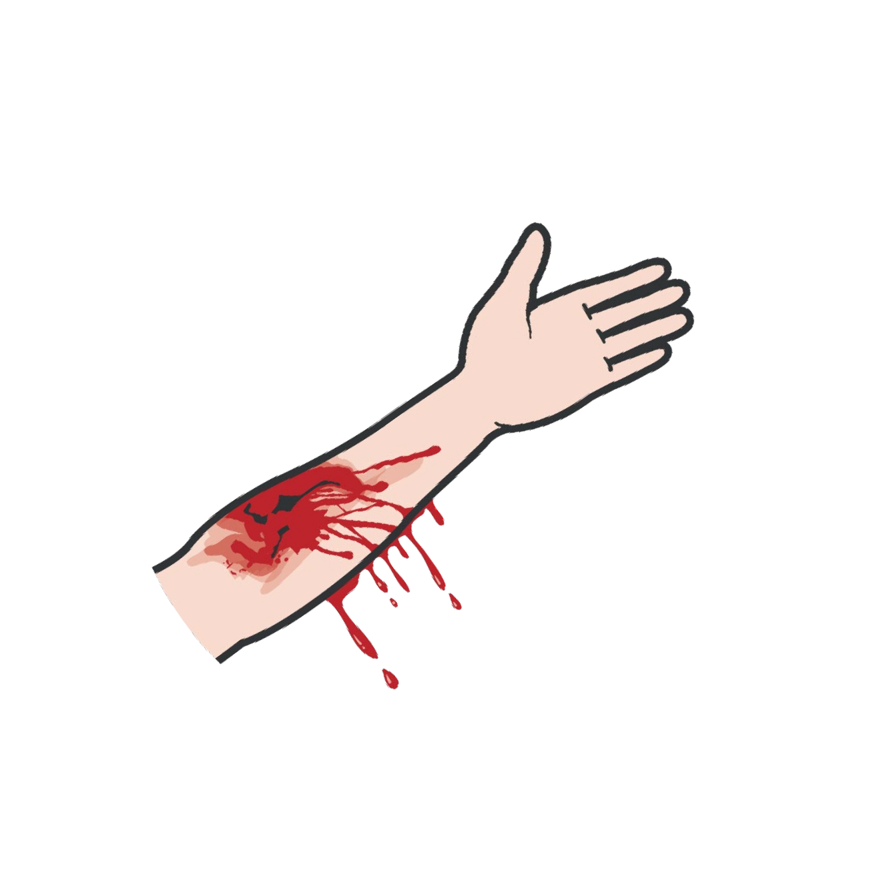
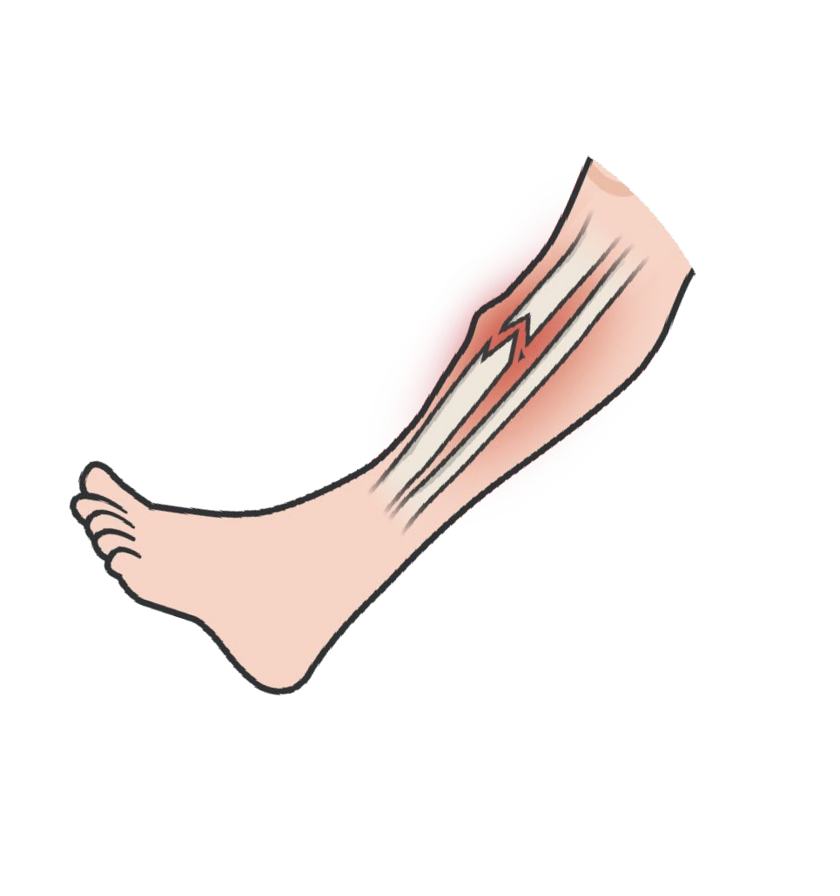
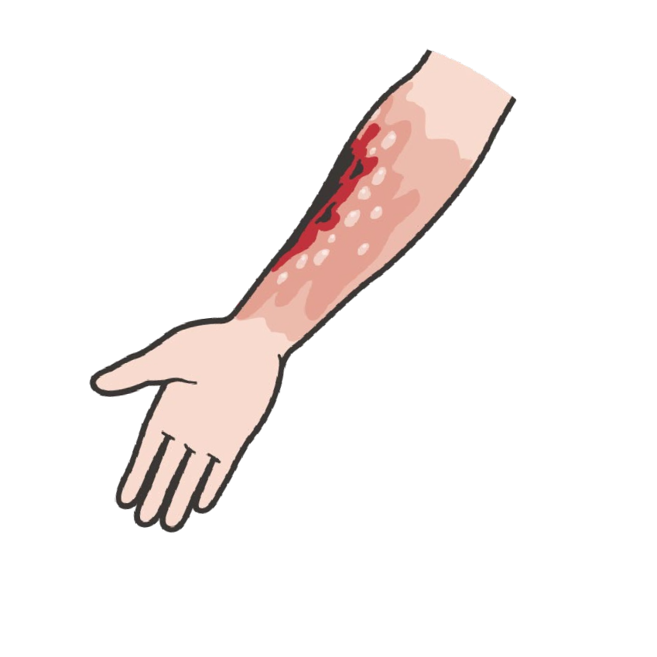
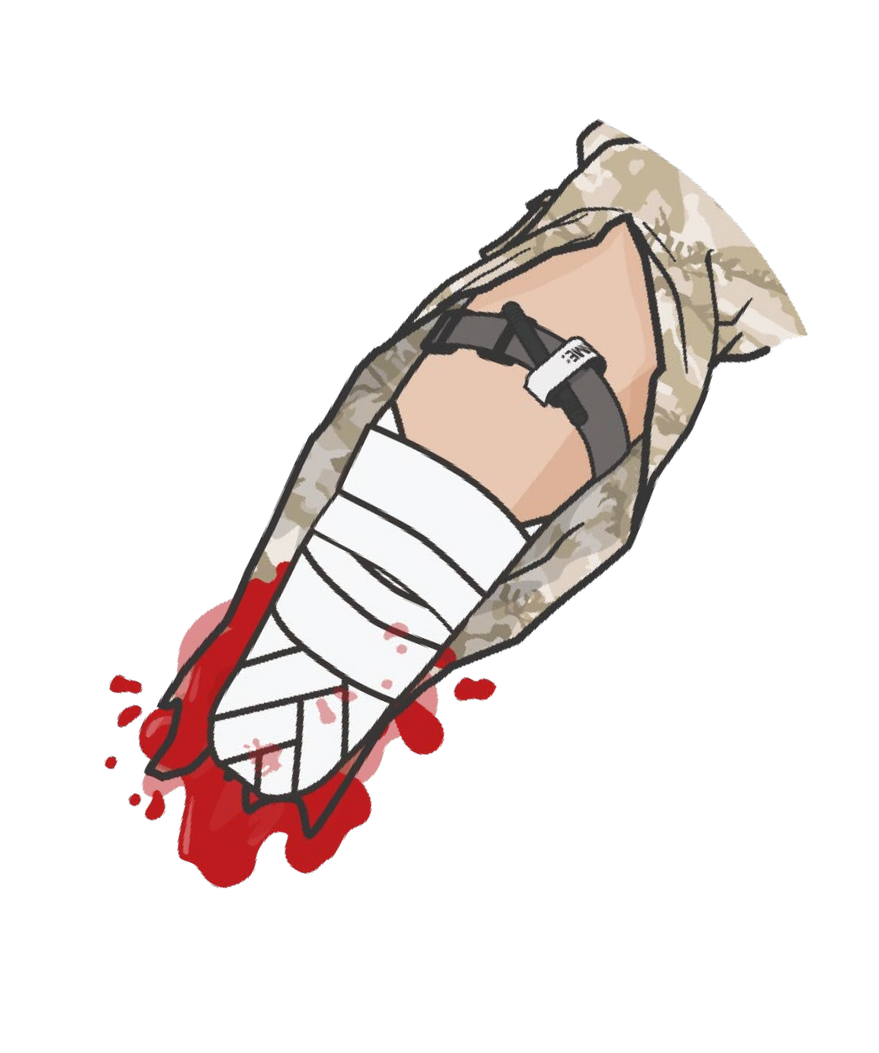
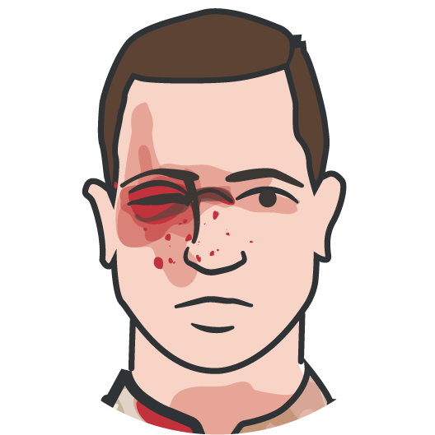
INDICATIONS AND CONTRAINDICATIONS TO ANTIBIOTICS IN TFC
Module 16: Antibiotic Administration
Antibiotics are indicated in all open combat wounds, regardless of the mechanism of injury
Choosing the best antibiotics
Effectiveness across a broad range of pathogens
Minimal side effects Environmental stability
Simple and infrequent dosage regimens
Comparatively low cost
Open
Fractures Burns
Amputations
Eye Injuries
Bleeding
Very good safety profile of oral and parenteral antibiotics on the battlefield
Prehospital antibiotic therapy is NOT indicated solely for burns.
Only contraindication is a known drug allergy
Oral - Moxifloxacin
Parenteral - Ertapenem
P A W S
#TCCC-CPP-PPT-16 08 AUG 23
Notes:
Antibiotics are indicated in all open wounds, regardless of the mechanism of injury. Proper wound care, including irrigating the wound, should be performed; but even when wounds are properly treated, antibiotics should be initiated.¹⁰
Prehospital antibiotic therapy is NOT indicated solely for burns.
Highlighting this issue, it should be noted that extremity injuries have been prevalent in recent conflicts and infections have caused significant morbidity.¹¹ For example, osteomyelitis has been reported in up to 9% of type III tibia fractures, and extremity infections have led to decreased success in limb salvage, an increase in additional surgical procedures and late amputations, as well as a decrease in the likelihood of the casualty being able to return to duty.¹²
As just mentioned, the safety profile of both oral and parenteral antibiotics on the battlefield has been very good, and the only contraindication is a known drug allergy. As with any medication, there is a small risk of an adverse drug reaction that would require management, but to date that has rarely happened and the benefits of early infection prevention far outweigh the small risk of an adverse reaction.
One of the considerations in choosing the best antibiotic is the need for effectiveness across a broad range of pathogens, as opposed to the process of choosing antibiotics in a normal clinical setting where you use the wound site, potential pathogens known to exist in the environment, and the patient’s health status to determine the best treatment choice. Also, a desire for minimal side effects, environmental stability, simple and infrequent dosage regimens, and comparatively low cost are all important considerations.¹³
Since 2002, fourth-generation fluoroquinolones have been the oral antibiotic of choice.¹⁴ Cefoxitin,¹⁵ and later the second-generation cephalosporin cefotetan, were initially the parenteral antibiotics of choice.¹⁶ But in 2011 ertapenem (a carbapenem antibiotic) was added as an alternative option, and then in 2017 ertapenem became the antibiotic of choice.¹⁷ Ertapenem and moxifloxacin are not ideal prophylaxis for every type of wound, but they are safe and effective broad-spectrum antibiotics. They are also recommended for prehospital care of penetrating wounds of the chest or abdomen in the current Joint Trauma System Infection Prevention Clinical Practice Guideline.¹⁸

Slide 7
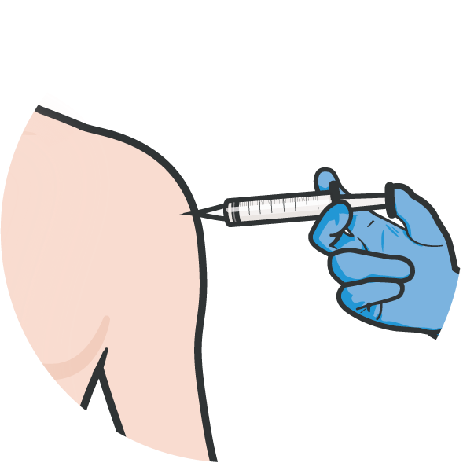
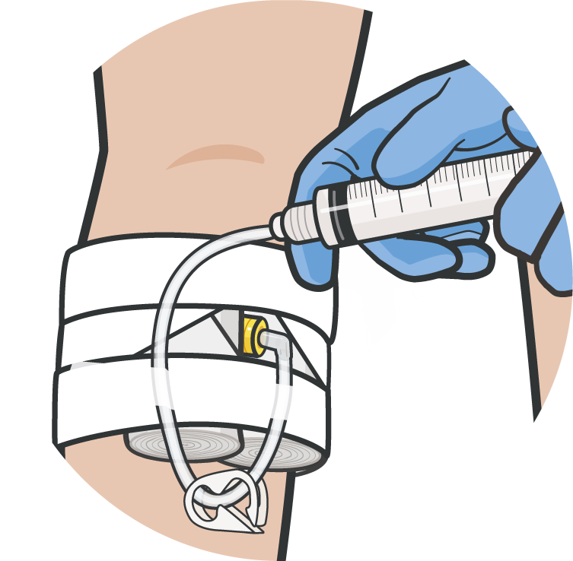
METHODS OF ADMINISTRATION OF ANTIBIOTICS IN TFC
Module 16: Antibiotic Administration
The two methods of administering antibiotics in the tactical setting:
Oral route preferred because Fewer supplies to carry No reconstitution needed
By mouth
By parenteral injection
(intramuscular, intravenous or intraosseous)
Saves resources and time spent injecting or infusing parenteral medications
Parenteral administration required if: Unconscious
Cannot swallow In shock
Antibiotic therapy should be accompanied by
Wound irrigation
Surgical debridement when situation permits
Immunization for tetanus Appropriate post-surgical care
Level of Evidence: C-EO
P A W S
#TCCC-CPP-PPT-16 08 AUG 23
Notes:
The two methods of administering antibiotics in the tactical setting are by mouth or by parenteral (intramuscular, intravenous, or intraosseous) injection.
The logistical issues associated with carrying, reconstituting, and then injecting or infusing parenteral medications makes use of oral antibiotics the preferred route, when oral administration is possible.¹⁹
Parenteral administration of antibiotics is required in casualties who are unconscious or who cannot take medications by mouth (for example, due to maxillofacial injuries). It is also required for casualties in shock, in whom the gastrointestinal tract blood flow may be inadequate for absorption of oral medications.
Prophylactic antibiotic therapy should be accompanied by wound irrigation, surgical debridement of the wound when the situation permits, immunization for tetanus, and appropriate post-surgical care of the wound in order to minimize the risk of wound infection.²⁰
The evidence supporting the method of antibiotic administration, is largely Clinical Consensus, Expert Opinion & Discussion statements in review articles.

Slide 8
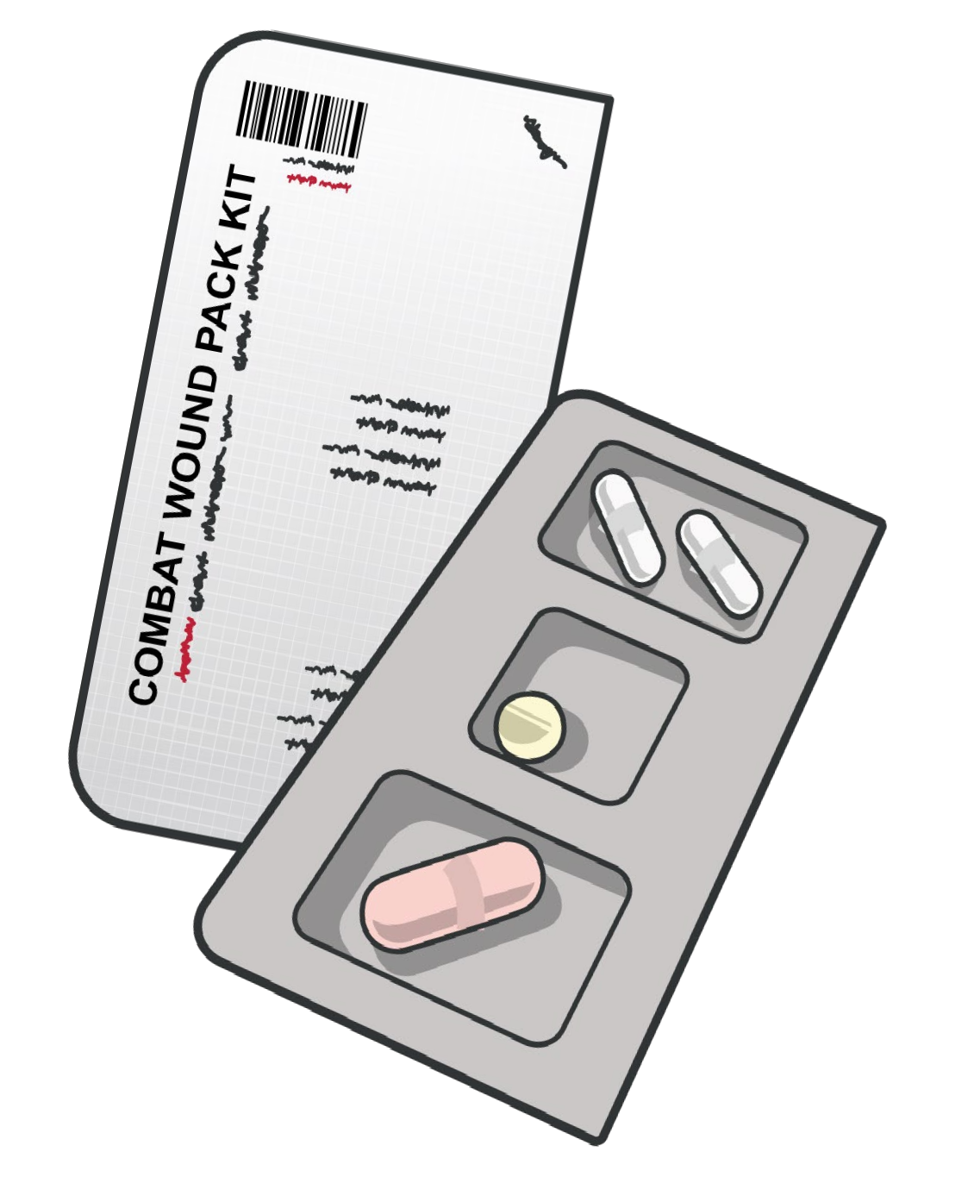



INDICATIONS, DOSAGE, AND ADMINISTRATION OF MOXIFLACIN
Module 16: Antibiotic Administration
Casualty with open combat wounds able to swallow:
MOXIFLACIN Dosing in TFC
ADVANTAGES:
Excellent intraocular penetration when taken systemically
Effective for most gram-positive and gram-negative bacteria; ideal for treatment of eye injuries
Minimal to no mission impact
400mg PO once a day (from CWMP)
ONSET/PEAK/DURATION:
DRUG INTERACTIONS:
1 hr/2 hr/20-24 hr
Iron, zinc, antacids, aluminum, magnesium, calcium, and sucralfate decrease absorption, atenolol, cisapride, erythromycin, antipsychotics, TCAs, quinidine, procainamide, amiodarone, sotalol may prolong QTc interval, may cause false
CONTRAINDICATION:
Fluoroquinolone allergy
positive on opiate screening tests
Document time of administration on casualty DD Form 1380
Level of Evidence: C-LD
P A W S
#TCCC-CPP-PPT-16 08 AUG 23
8
Notes:
If the casualty is not in shock and can swallow oral medications, they should be given a 400 mg tablet of moxifloxacin.²¹ This is the dose found in the casualty’s Combat Wound Medication Pack (or CWMP). They should use their own medication, unless for some reason they no longer have access to their own CWMP. Advise them to take it with water and be sure to document the time of administration on their DD Form 1380, TCCC Casualty Card.
Other fluoroquinolones may occasionally be found at forward locations, but moxifloxacin is the quinolone of choice at this point. Gatifloxacin was previously recommended²² but was later reported to cause disorders of glucose metabolism and was subsequently replaced.²³ And levofloxacin has been considered based on its effectiveness against gram-negative bacteria; but even with some recent increase in drug-resistant strains,²⁴ no change has been recommended.
Moxifloxacin has excellent intraocular penetration when taken systemically (as opposed to other antibiotics which require intravitreal injection) and is effective for most gram-positive and gram-negative bacteria that might cause post-injury endophthalmitis, which is another advantage when dealing with eye injuries.²⁵
There is mostly retrospective registry review, lab evaluation observational study with limitations supporting the choice of moxiflacin and on its use in tactical settings and randomized trials on non-combat wound management.
Individuals with known medication allergies to the fluoroquinolone class of medications should be identified, as they may require a different class of antibiotics. Examples of this include the two just mentioned, gatifloxacin and levofloxacin, as well as ciprofloxacin. You should screen your troops for medication allergies prior to deploying, when you provide them with Combat Wound Medication Packs, and be aware of any allergies that members may have to medications recommended in the TCCC Guidelines. If an individual should not take moxifloxacin, determine the appropriate substitute antibiotic (in consultation with your medical officer if you are not the individual’s provider).
Drug interactions include; iron, zinc, antacids, aluminum, magnesium, calcium, and sucralfate decrease absorption, atenolol, cisapride, erythromycin, antipsychotics, TCAs, quinidine, procainamide, amiodarone, sotalol may prolong QTc interval, may cause false positive on opiate screening tests.
The Onset/Peak/Duration for moxifloxacin is 1 hr/2 hr/20-24 hr.
The casualty should use their own medication, unless for some reason they no longer have access to their own CWMP.
Moxifloxacin has excellent intraocular penetration when taken systemically (as opposed to other antibiotics which require intravitreal injection) and is effective for most gram-positive and gram-negative bacteria that might cause post-injury endophthalmitis, which is another advantage when dealing with eye injuries.
Other fluoroquinolones may occasionally be found at forward locations, but moxifloxacin is the quinolone of choice at this point. Gatifloxacin was previously recommended, but was later reported to cause disorders of glucose metabolism and was subsequently replaced. And levofloxacin has been considered based on its effectiveness against gram-negative bacteria; but with some recent increase in drug-resistant strains, no change has been recommended.
Individuals with known medication allergies to the fluoroquinolone class of medications should be identified, as they may require a different class of antibiotics. Examples of this include the two just mentioned, gatifloxacin and levofloxacin, as well as ciprofloxacin. You should screen your troops for medication allergies prior to deploying, when you provide them with Combat Wound Medication Packs, and be aware of any allergies that members may have to medications recommended in the TCCC Guidelines. If an individual should not take moxifloxacin, consult with your medical officer to determine the appropriate substitute antibiotic.

Slide 9


INDICATIONS, DOSAGE, AND ADMINISTRATION OF ERTAPENEM
Module 16: Antibiotic Administration
Casualty with open combat
wounds in shock, unconscious, and unable to swallow:
ERTAPENEM Dosing in TFC
DRUG INTERACTIONS:
Parenteral antibiotic of choice based on:
Probenecid decreases renal excretion
Once-a-day dosing
Excellent broad-spectrum coverage
Good safety profile
1 gm IV or IO reconstitute with 10ml saline or bacteriostatic water – don’t mix with dextrose or infuse with other meds
1 gm IM reconstitute with 3.2ml of 1% lidocaine (without epinephrine)
CONTRAINDICATION:
Beta-lactam allergy (penicillin, cephalosporins) or lidocaine (for IM injections)
Know unit members’ allergies prior to deployment
ONSET/PEAK/DURATION:
30 sec-5 min/30 min-2 hr/24hr
Document time of administration on casualty DD Form 1380
Level of Evidence: C-EO
P A W S
Notes:
If the casualty is in shock or unconscious, or cannot swallow oral medications, they should be given one gram of ertapenem. This can be administered by intramuscular, intravenous, or intraosseous injection. As with any medication or treatment, the medication, dose, and the time of administration should be documented on the DD Form 1380.²⁶
Ertapenem became the parenteral antibiotic of choice based on its once-a-day dosing, its excellent broad-spectrum coverage, and its good safety profile.²⁷
Ertapenem should not be mixed or co-infused with other medications to prevent crystallization and should not be mixed with diluents containing dextrose. It may be administered intramuscularly (IM) if needed. However, in that case it should be reconstituted with 3.2 mL of 1.0% lidocaine HCl (without epinephrine), instead of saline or bacteriostatic water.²⁸
Ertapenem is a member of the carbapenem family of the beta-lactam class of antibiotics. As such, it is contraindicated in persons with known anaphylactic reactions to other beta-lactams including penicillin's and cephalosporins. Also, since ertapenem is reconstituted with lidocaine for IM injection, it cannot be given IM to persons with known hypersensitivity to lidocaine. As with moxifloxacin, if an individual in your unit should not take ertapenem, determine an appropriate substitute antibiotic (or consult with your medical officer if you are not the individual’s provider).
There is mostly Clinical Consensus, Expert Opinion and Discussion supporting the choice of ertapenem and on its use in tactical settings and randomized trials on non-combat wound management.
Drug interactions include; probenecid decrease renal excretion.
The Onset/Peak/Duration for ertapenem is 30 sec-5 min/30 min-2 hr/24hr.
Ertapenem should not be mixed or co-infused with other medications to prevent crystallization and should not be mixed with diluents containing dextrose. It may be administered intramuscularly (IM) if needed. However, in that case it should be reconstituted with 3.2 mL of 1.0% lidocaine HCl (without epinephrine), instead of saline or bacteriostatic water.
Ertapenem became the parenteral antibiotic of choice based on its once-a-day dosing, its excellent broad-spectrum coverage, and its good safety profile.

Slide 10

Module 16: Antibiotic Administration
ANTIBIOTIC ADMINISTRATION OVERVIEW
Video can be found on deployedmedicine.com
Notes:
The following video will recap some of the important concepts of antibiotics in the Tactical Field Care setting.

Slide 11

ANTIBIOTIC ADMINISTRATION
Instructor-Led Demonstration
Module 16: Antibiotic Administration
RECONSTITUTION OF POWDERED MEDICATION
(Trainer-led demonstration and/or student-led review of the reconstitution of IV parenteral antibiotic administration/key steps)
Notes:
In the skills station, we will practice identifying the basic sequence of a tactical trauma assessment without focusing on interventions that will be covered in later modules. By the end of the course, you should be prepared to perform a TTA to include all necessary interventions.

Slide 12
SKILL STATION
Module 16: Antibiotic Administration
Antibiotic Administration
Moxifloxacin (oral) antibiotic administration Ertapenem (parenteral) antibiotic administration
Notes:
The following skill cards will help you demonstrate the preparation and administration of CoTCCC-recommended antibiotics in Tactical Field Care.

Slide 13

Module 16: Antibiotic Administration
EVIDENCE SUPPORTING TCCC ANTIBIOTIC STRATEGIES
Subject Category | Study Types | Level of Evidence
Early Administration of Antibiotics | Retrospective registry review, Lab evaluation observational study with limitations | C-LD
Methods of Antibiotic Administration | Clinical Consensus, Expert Opinion & Discussion | C-EO
Oral Antibiotic (moxifloxacin) Selection | Retrospective registry review, Lab evaluation observational study with limitations | C-LD
Parenteral Antibiotic (ertapenem) Selection | Clinical Consensus, Expert Opinion & Discussion | C-EO
Notes:
As with the other TCCC training modules, the evidence supporting the progressive strategies, indications, and limitations of antibiotic therapy in Tactical Field Care is complex. For some of the recommendations, there is clear-cut supporting evidence, while for others a consensus of subject matter expert opinions has informed the guidance.
Reviewing the indications, limitations, and strategies of antibiotic therapy, potential categories to highlight include the importance of early antibiotic administration, the indications (and contraindications) for the use of antibiotics in TFC, the method of antibiotic administration, and the choice of specific oral and parenteral antibiotics for TFC.
The importance of early antibiotic administration is supported by several well-designed retrospective human studies and some randomized and controlled animal studies.²⁹ The evidence of benefit from those studies makes it unnecessary to rely on a randomized and controlled human study that would subject the control arm to known adverse results.
The indications for antibiotics in the TFC setting is also supported by some of those same retrospective studies, along with a handful of others,³⁰ most of which are well-designed retrospective reviews. The results were positive, but not as clear-cut as with the early antibiotic administration.
The method of antibiotic administration is supported by author opinion statements in review articles³¹ by subject matter consensus and has a lower quality of supporting evidence.
The choice of both oral and parenteral antibiotics is supported by several retrospective studies on use in the tactical setting, as well as several randomized trials in clinical literature for non-combat wound management with similar injuries, and overall has a moderate to high level of quality evidence.

Slide 14

Module 16: Antibiotic Administration
ASSESSING THE EVIDENCE FOR GUIDELINES
Level of Evidence | AHA Recommendation System Terminology Explanation | Why the AHA Classification System?
A | Evidence from multiple randomized clinical trials (RCT) with concordant results or from HIGH-QUALITY meta-analyses. | The level of evidence recommendations allow readers to quickly glean information on the strength, certainty, and quality of evidence supporting each recommendation. A recommendation with Level of Evidence (LOE) C does not imply that the recommendation is weak. Although, RCTs are unavailable, there may be a very clear clinical consensus that a particular test or therapy is useful or effective.
B-R | Evidence from moderate-quality trials, or a meta-analysis of moderate quality (RCT) followed by an R to denote RANDOMIZED studies
B-NR | Evidence from moderate-quality trials, or a meta-analysis of moderate quality followed by NR to denote NON-RANDOMIZED studies
C-LD | There is no convincing evidence and is followed by LD to indicate LIMITED DATA
C-EO | There is no convincing evidence and is followed by EO if the consensus is based on EXPERT OPINION, case studies or standards of care.
Notes:
Evidence-based recommendations and guidance are the result of a careful review of studies and discussion by a panel of subject matter experts. For TCCC, the subject matter expert panels include both Committee on TCCC members and select invited subject matter experts from within both the military and civilian community, based on the specific interest area.
Why the AHA Classification System?
The level of evidence classification combines an objective description of the existence and the types of studies supporting the recommendation and expert consensus, according to 1 of the following 3 categories:⁵⁴
Level of evidence A: recommendation based on evidence from multiple randomized trials or meta-analyses
Level of evidence B: recommendation based on evidence from a single randomized trial or nonrandomized studies
Level of evidence C: recommendation based on expert opinion, case studies, or standards of care.
The level of evidence recommendations allows readers to quickly glean information on the strength, certainty, and quality of evidence supporting each recommendation. The Level of Evidence (LOE) denotes the confidence in or certainty of the evidence supporting the recommendation, based on the type, size, quality, and consistency of pertinent research findings.⁵⁵
A recommendation with level of evidence C does not imply that the recommendation is weak. Many important clinical questions addressed in guidelines do not lend themselves to clinical trials. Although, Randomized Clinical Trials are unavailable, there may be a very clear clinical consensus that a particular test or therapy is useful or effective.

Slide 15
SUMMARY
Module 16: Antibiotic Administration
Knowledge Topics Skills and Abilities
The importance of early antibiotic administration
General indications and methods of antibiotic administration
Indications and considerations for administering moxifloxacin
Indications and considerations for administering ertapenem
Evidence supporting the strategies for antibiotic administration methods in TFC
Oral Antibiotic Administration Parental Antibiotic Administration
Notes:
This module provided a good overview of antibiotics in Tactical Field Care.
The importance of using antibiotics early in battlefield wounds and the general indications and methods of antibiotic administration were reviewed.
The indications and considerations for administering moxifloxacin and ertapenem were also discussed.
Additionally, the evidence for the strategies behind the use of antibiotics in the TFC setting were highlighted.
And the preparation and administration of antibiotics skills were demonstrated in a breakout session.

Slide 16

CHECK ON LEARNING
Module 16: Antibiotic Administration
What is the oral antibiotic of choice and its dose?
When should you use ertapenem instead of moxifloxacin as an antibiotic therapy?
What are the advantages of using an oral antibiotic over a parenteral antibiotic?
When should you administer antibiotics in the Tactical Field Care phase?
Notes:
To close out this module, check your learning with the questions below (answers under the image).
Answers
What is the oral antibiotic of choice and its dose?
If the casualty is not in shock and can swallow oral medications, they should be given a 400 mg tablet of moxifloxacin.
When should you use ertapenem instead of moxifloxacin as an antibiotic therapy?
If the casualty is in shock or unconscious, or cannot swallow oral medications, they should be given one gram of ertapenem.
What are the advantages of using an oral antibiotic over a parenteral antibiotic?
\The logistical issues associated with carrying, reconstituting, and then injecting or infusing parenteral medications make oral antibiotics the preferred route, when oral administration is possible.
When should you administer antibiotics in the Tactical Field Care phase?
Antibiotics must be given as soon as possible after injury to maximize their ability to prevent wound infections.

Slide 17




Module 16: Antibiotic Administration
ANY QUESTIONS?

Slide 18


REFERENCES
Module 16: Antibiotic Administration
TCCC: Guidelines
by JTS/CoTCCC
These guidelines, updated regularly, are the result of decisions made by CoTCCC in exploring evidence- based research on best practices.
PHTLS: Military Edition, Chapter 25
by NAEMT
Prehospital Trauma Life Support (PHTLS), Military Edition, teaches and reinforces the principles of rapidly assessing a trauma patient using an orderly approach.
Notes:
¹ Poole LT. Army progress with penicillin. Br J Surg. 1944;32(125):110–111.
² Scott R Jr. Care of the battle casualty in advance of the aid station. Medical Science Publication No. 4, Volume 1. US Army Medical Department Office of Medical History website. http://history.amedd.army.mil/booksdocs/korea/recad1/ch1-4.html. Accessed March 14, 2019.
³ Mabry RL, Holcomb JB, Baker AM, et al. United States Army Rangers in Somalia: an analysis of combat casualties on an urban battlefield. J Trauma. 2000;49(3):515–528.
⁴ Butler FK, Hagmann J, Butler EG. Tactical combat casualty care in special operations. Mil Med. 1996;161(suppl):3–16.
⁵ Tarpey MJ. Tactical Combat Casualty Care in Operation Iraqi Freedom. US Army Med Dep J. April-June 2005;38-41.
⁶ MSG Ted Westmoreland; Special Operations Medical Association presentation 2004.
⁷ Penn-Barwell J, Murray C, Wenke J. Early antibiotics and debridement independently reduce infection in an open fracture model. J Bone Joint Surg Br. 2012 Jan;94(1):107-112.
⁸ Butler FK, Holcomb JB, Giebner SD, McSwain NE, Bagian J. Tactical combat casualty care 2007: evolving concepts and battlefield experience. Mil Med. 2007;172(11) (suppl):1–19.
⁹ O’Connor K, Butler F. Antibiotics in tactical combat casualty care 2002. Mil Med. 2003;168(11):911-914.
¹⁰ Hospenthal DR, Murray CK, Andersen RC, et al. Guidelines for the prevention of infections associated with combat-related injuries: 2011 update: endorsed by the Infectious Diseases Society of America and the Surgical Infection Society. J Trauma. 2011 Aug;71(2 Suppl 2):S210-234.
¹¹ Murray CK, Hsu JR, Solomkin JS, et al. Prevention and management of infections associated with combat-related extremity injuries. J Trauma. 2008 Mar;64(3 Suppl):S239-51.
¹² Yun H, Murray C, Nelson K, Bosse M. Infection after orthopaedic trauma: prevention and treatment. J Orthop Trauma. 2016 Oct;30 Suppl 3:S21-S26.
¹³ Prehospital Trauma Life Support, Military 9th Edition, 15 Oct 2019, page 827.
¹⁴ O’Connor K, Butler F. Antibiotics in tactical combat casualty care 2002. Mil Med. 2003;168(11):911-914.
¹⁵ Butler FK, Hagmann J, Butler EG. Tactical combat casualty care in special operations. Mil Med. 1996;161(suppl):3–16.
¹⁶ Butler FK, Holcomb JB, Giebner SD, McSwain NE, Bagian J. Tactical combat casualty care 2007: evolving concepts and battlefield experience. Mil Med. 2007;172(11) (suppl):1–19.
¹⁷ Montgomery H, Butler FK, TCCC Guidelines Comprehensive Review and Update, Journal of Special Operations Medicine, 2017; (17 Edition 2) 21-38.
¹⁸ https://jts.amedd.army.mil/assets/docs/cpgs/Infection_Prevention_in_Combat-related_Injuries_27_Jan_2021_ID24.pdf, accessed 30 Aug 21.
¹⁹ Butler FK, Hagmann JH, Richards DT. Tactical management of urban warfare casualties in special operations. Mil Med. 2000 Apr;165(4 Suppl):1-48.
²⁰ https://jts.amedd.army.mil/assets/docs/cpgs/Infection_Prevention_in_Combat-related_Injuries_27_Jan_2021_ID24.pdf, accessed 30 Aug 21.
²¹ Tactical Combat Casualty Care Guidelines, 15 December 2021, https://deployedmedicine.com/market/31/content/40, accessed 15 Dec 21.
²² Murray CK, Hospenthal D. Antibiotics Use and Selection at the Point of Injury in Tactical Combat Casualty Care. JSOM. 2005; 5(3):56-61.
²³ Yamada C, Nagashima K, Takahashi A, et al. Gatifloxacin acutely stimulates insulin secretion and chronically suppresses insulin biosynthesis. Eur J Pharmacol. 2006;553(1-3):67-72.
²⁴ Murray CK. Field Wound Care: Prophylactic Antibiotics. Wilderness Environ Med. 2017 Jun;28(2S): S90-S102.
²⁵ Ahmed S, Kuruvilla O, Chin Yee D, et al. Intraocular penetration of systemic antibiotics in eyes with penetrating ocular injury. J Ocul Pharmacol Ther. 2014 Dec;30(10):823-830
²⁶ Tactical Combat Casualty Care Guidelines, 15 December 2021, https://deployedmedicine.com/market/31/content/40, accessed 15 Dec 21.
²⁷ Hospenthal DR, Murray CK, Anderson RC, et al. Guidelines for prevention of infection after combat-related injuries. J Trauma. 2008;64(3)(suppl):S211–S220.
²⁸ https://www.merck.com/product/usa/pi_circulars/i/invanz/invanz_pi.pdf; accessed on 30 Aug 21.
²⁹ Prior references 2,3,4,5,6,7,8,9
³⁰ Prior references 10,11,12,13
³¹ Prior reference 19
³² Ahmed S, Kuruvilla O, Chin Yee D, et al. Intraocu¬lar penetration of systemic antibiotics in eyes with penetrating ocular injury. J Ocul Pharmacol Ther. 2014 Dec;30(10):823-830. C-LD
³³ Blyth D, Yun H, Tribble D, Murray C. Lessons of war: combat-related injury infections during the Vietnam War and Operation Iraqi and Enduring Freedom. J Trauma Acute Care Surg. 2015 Oct;79(4 Suppl 2):S227-S235. C-LD
³⁴ Butler FK, Hagmann J, Butler EG. Tactical combat casualty care in special operations. Mil Med. 1996;161(suppl):3–16. C-EO
³⁵ Butler FK, Hagmann JH, Richards DT. Tactical management of urban warfare casualties in special operations. Mil Med. 2000 Apr;165(4 Suppl):1-48. C-EO
³⁶ Butler FK, Holcomb JB, Giebner SD, McSwain NE, Bagian J. Tactical combat casualty care 2007: evolving concepts and battlefield experience. Mil Med. 2007;172(11) (suppl):1–19. C-EO
³⁷ Hopkins T, Daley M, Rose D, et al. Presumptive antibiotic therapy for civilian trauma injuries. J Trauma Acute Care Surg. 2016 Oct;81(4):765-774. B-R
³⁸ Hospenthal DR, Murray CK, Andersen RC, et al. Guidelines for the prevention of infections associated with combat-related injuries: 2011 update: endorsed by the Infectious Diseases Society of America and the Surgical Infection Society. J Trauma. 2011 Aug;71(2 Suppl 2):S210-234. C-EO
³⁹ Hospenthal DR, Murray CK, Anderson RC, et al. Guide¬lines for prevention of infection after combat-related inju¬ries. J Trauma. 2008;64(3)(Suppl):S211-S220. C-EO
⁴⁰ Lack W, Karunakar M, Angerame M, et al. Type III open tiba fractures: immediate antibiotic prophylaxis mini¬mizes infection. J Orthop Trauma. 2016;29(1):1-6. B-NR
⁴¹ Mabry RL, Holcomb JB, Baker AM, et al. United States Army Rangers in Somalia: an analysis of combat casualties on an urban battlefield. J Trauma. 2000;49(3):515–528. C-LD
⁴² Mellor SG, Cooper GJ, Bowyer GW. Efficacy of delayed administration of benzylpenicillin in the control of infec¬tion in penetrating soft tissue injuries in war. J Trauma. 1996;40(Suppl 3):S128-S134. C-LD
⁴³ Montgomery H, Butler FK, TCCC Guidelines Comprehensive Review and Update, Journal of Special Operations Medicine, 2017; (17 Edition 2) 21-38. C-EO
⁴⁴ Murray CK, Hospenthal D. Antibiotics Use and Selection at the Point of Injury in Tactical Combat Casualty Care. JSOM. 2005; 5(3):56-61. C-EO
⁴⁵ Murray CK, Hsu JR, Solomkin JS, et al. Prevention and management of infections associated with combat-related extremity injuries. J Trauma. 2008 Mar;64(3 Suppl):S239-51. C-LD
⁴⁶ Murray CK. Epidemiology of infections associated with combat-related injuries in Iraq and Afghanistan. J Trauma. 2008 Mar;64(3 Suppl):S232-S238. C-LD
⁴⁷ O’Connor K, Butler F. Antibiotics in tactical combat casualty care 2002. Mil Med. 2003;168(11):911-914. C-EO
⁴⁸ Penn-Barwell J, Murray C, Wenke J. Early antibiotics and debridement independently reduce infection in an open fracture model. J Bone Joint Surg Br. 2012 Jan;94(1):107-112. B-NR
⁴⁹ Poole LT. Army progress with penicillin. Br J Surg. 1944;32(125):110–111. C-LD
⁵⁰ Scott R Jr. Care of the battle casualty in advance of the aid station. Medical Science Publication No. 4, Volume 1. US Army Medical Department Office of Medical History website. http://history.amedd.army.mil/booksdocs/korea/recad1/ch1-4.html. Accessed March 14, 2019. C-LD
⁵¹ Tarpey MJ. Tactical Combat Casualty Care in Operation Iraqi Freedom. US Army Med Dep J. April-June 2005;38-41. C-LD
⁵² Yamada C, Nagashima K, Takahashi A, et al. Gatifloxacin acutely stimulates insulin secretion and chronically suppresses insulin biosynthesis. Eur J Pharmacol. 2006;553(1-3):67-72. B-NR
⁵³ Yun H, Murray C, Nelson K, Bosse M. Infection after orthopaedic trauma: prevention and treatment. J Orthop Trauma. 2016 Oct;30 Suppl 3:S21-S26. C-LD
⁵⁴ Tricoci P, Allen JM, Kramer JM, Califf RM, Smith Jr SC. Scientific Evidence Underlying the ACC/AHA Clinical Practice Guidelines. American Medical Association. 2009 Feb; Vol 301, No. 8.
⁵⁵ Halparin, JL. Further Evolution of the ACC/AHA Clinical Practice Guideline Recommendation Classification System. American College of Cardiology Foundation and the American Heart Association. 2016 Apr; 133:1426-1428.

